Slide 1


Computer Vision with YOLO
From Basics to Deployment
Technical Interview Preparation Guide

Slide 2

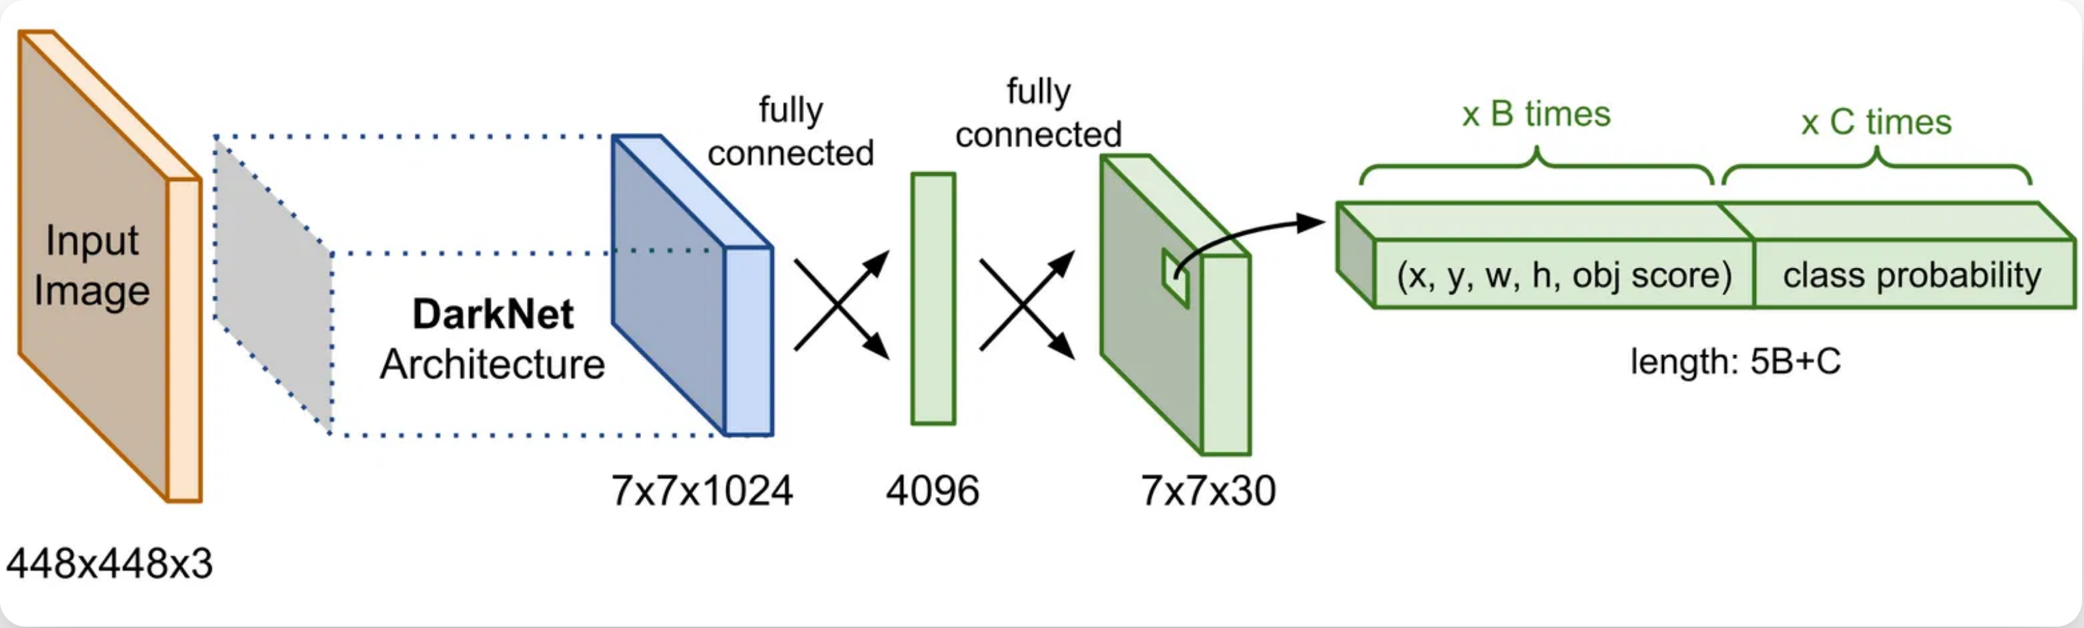

Computer Vision with YOLO: From Basics to Deployment
YOLO Architecture & Working Principles
You Only Look Once: Single-Pass Object Detection
Single-Stage Detection:
Processes the entire image in one pass, predicting bounding boxes and class probabilities directly.
Grid-Based Approach:
Divides image into SxS grid cells, each responsible for detecting objects centered within it.
Anchor Boxes:
Predefined shapes that help better predict object dimensions and improve detection of overlapping objects.
# YOLO prediction format
[x_center, y_center, width, height, confidence, class_prob_1, class_prob_2, ...]
# Single forward pass through the network
predictions = model(image)
Key Components:
Backbone (feature extraction), Neck (feature aggregation), Head (detection).
Loss Function:
Combines localization loss (bounding box coordinates), confidence loss (objectness), and classification loss.
Non-Maximum Suppression:
Post-processing technique to eliminate redundant overlapping bounding boxes.
Speed vs. Accuracy:
Different model sizes (YOLOv5s, YOLOv5m, YOLOv5l, YOLOv5x) offer trade-offs between speed and accuracy.

Slide 3







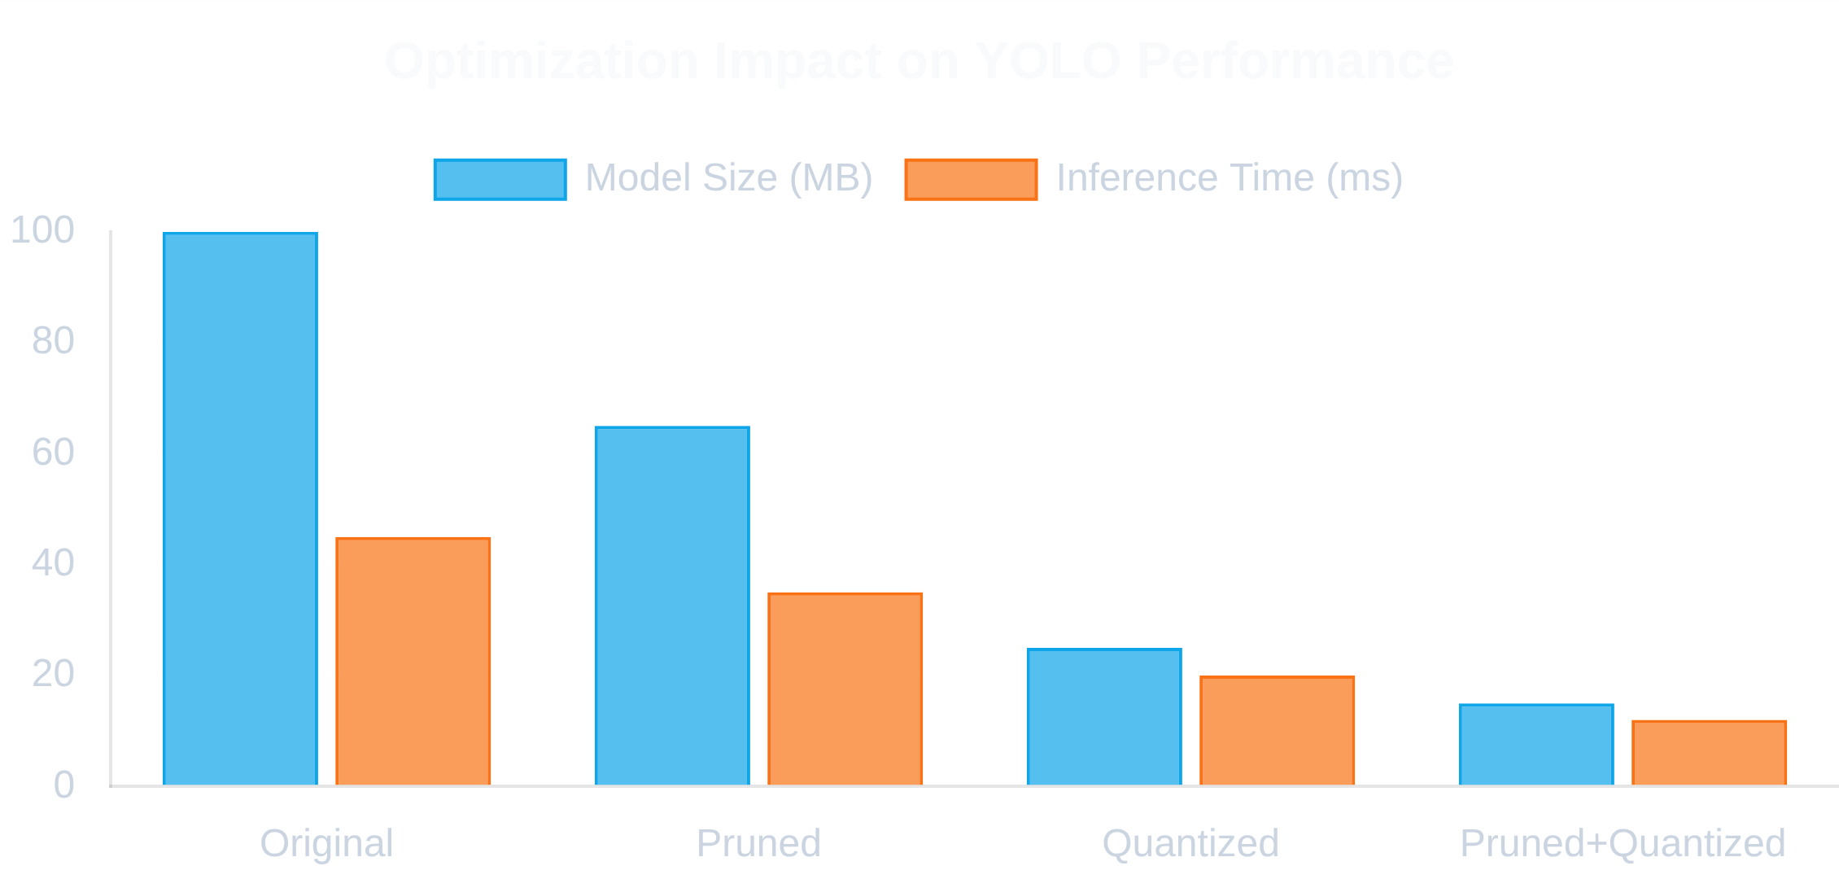

Computer Vision with YOLO: From Basics to Deployment
Optimization Techniques for YOLO
Enhancing Performance and Efficiency
Model Pruning:
Remove redundant connections and neurons to reduce model size without significant accuracy loss.
Quantization:
Convert floating-point weights to lower precision formats (INT8) to reduce memory footprint.
Batch Processing:
Process multiple images simultaneously to better utilize GPU parallelism.
TensorRT Integration:
Convert models to TensorRT format for hardware-specific optimizations.
Input Resolution:
Find optimal balance between accuracy and speed by adjusting input size.
Deployment Optimization:
Tailor models for specific environments (AWS Lambda, edge devices).

Slide 4

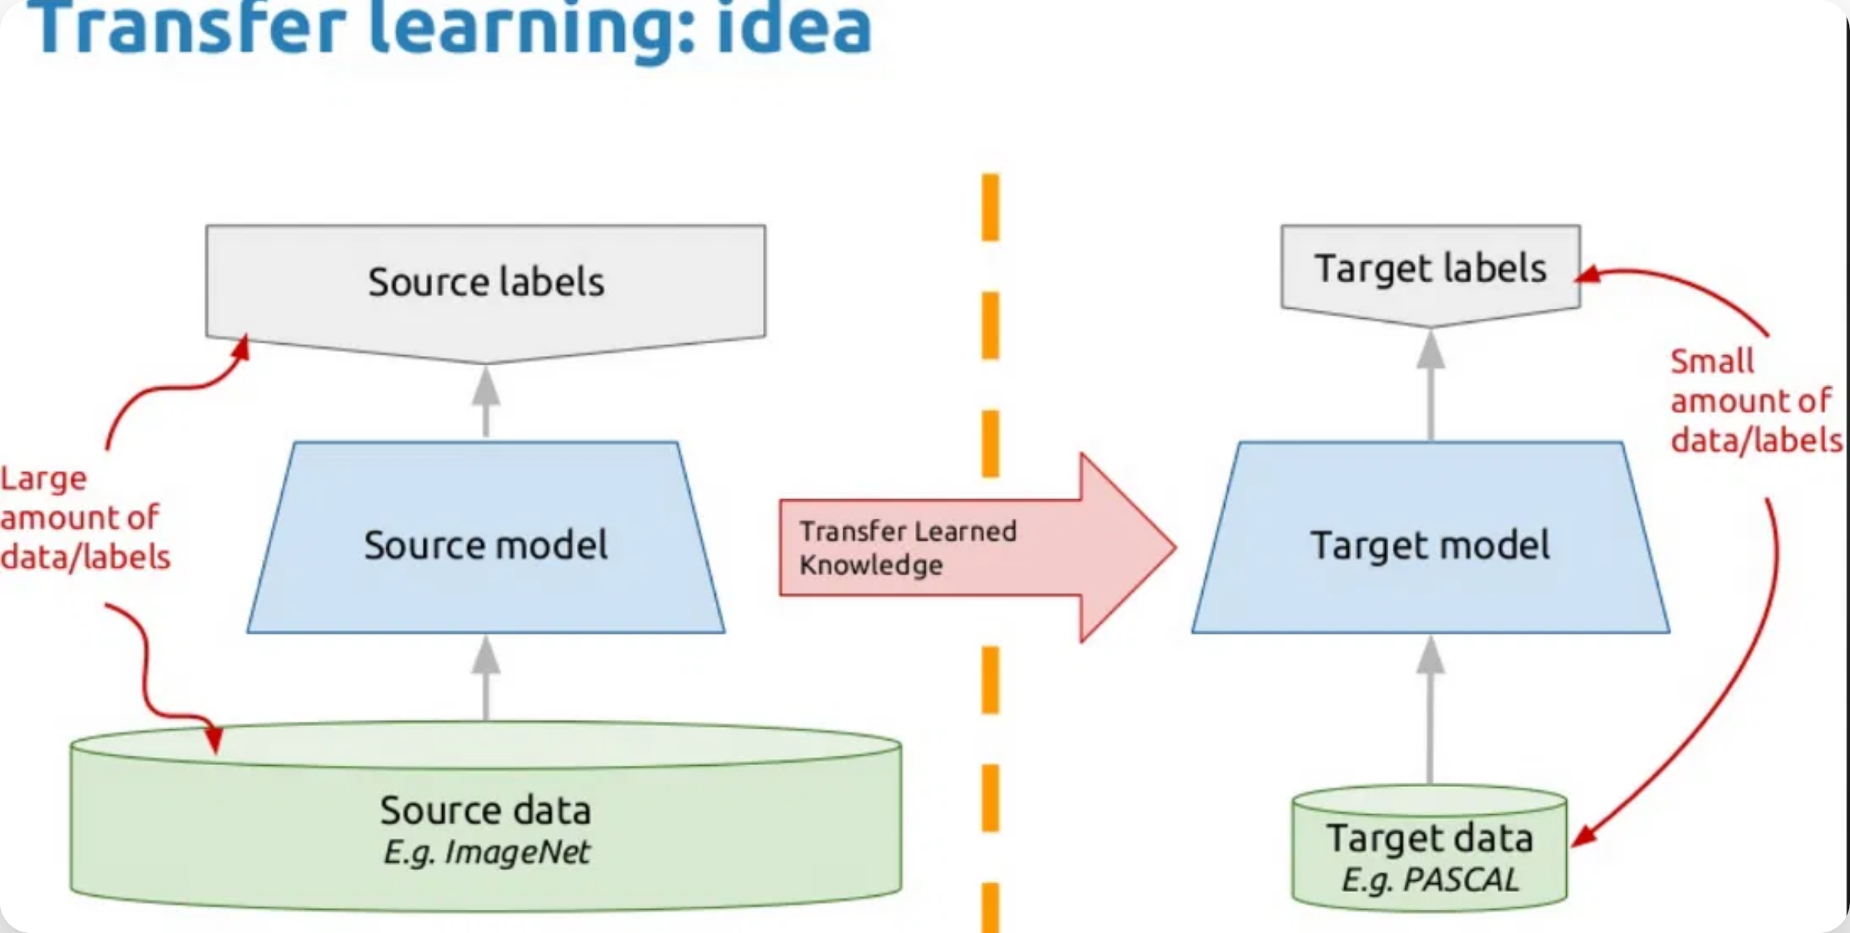




Computer Vision with YOLO: From Basics to Deployment
Transfer Learning with YOLO
Leveraging Pre-trained Models for New Tasks
Reduced Training Time:
Converges faster than training from scratch, often by 5-10x.
Less Data Required:
Achieve good results with smaller custom datasets (hundreds vs. thousands of images).
Better Performance:
Higher accuracy and lower overfitting on domain-specific tasks.
Lower Compute Needs:
Train effectively with less powerful hardware.
1
Start with Pre-trained Model
Implementation Example:
Begin with a YOLO model pre-trained on a large dataset like COCO.
# Load pre-trained YOLOv5 model
model = torch.hub.load('ultralytics/yolov5', 'yolov5s')
# Freeze backbone layers
for param in model.model.model[:10].parameters():
param.requires_grad = False
# Modify detection head for custom classes
model.model.model[24].nc = num_classes
# Fine-tune on custom dataset
results = model.train(
data='custom.yaml',
epochs=100,
batch_size=16,
lr=0.001
)
2
Freeze Backbone Layers
Lock the weights of feature extraction layers to preserve learned features.
3
Modify Detection Head
Adapt the final layers to match your specific number of classes.
4
Fine-tune on Custom Data
Train with your domain-specific dataset using a lower learning rate.

Slide 5





Computer Vision with YOLO: From Basics to Deployment
Structured JSON Output
Converting YOLO Outputs for Downstream Applications
Interoperability:
JSON is widely supported across programming languages and platforms.
{
"image_name"
,
:
"example_image.jpg"
: {
"image_dimensions"
Structured Data:
Hierarchical format provides clear organization of detection results.
,
"width"
:
640
"height"
:
480
},
Database Integration:
: [
{
Easy to store in document databases like MongoDB.
"detections"
,
"class_name"
:
"person"
API Friendly:
Perfect format for RESTful API responses.
,
"class_id"
:
0
,
"confidence"
:
0.95
: {
"box_2d"
# Python code to convert YOLO output to JSON
def yolo_to_json(detections, image_name, image_size):
results = {
"image_name": image_name,
"image_dimensions": {
"width": image_size[0],
"height": image_size[1]
},
"detections": []
}
for det in detections:
x, y, w, h, conf, cls = det
results["detections"].append({
"class_name": class_names[int(cls)],
"class_id": int(cls),
"confidence": float(conf),
"box_2d": {
"x_min": int((x - w/2) * image_size[0]),
"y_min": int((y - h/2) * image_size[1]),
"x_max": int((x + w/2) * image_size[0]),
"y_max": int((y + h/2) * image_size[1])
}
})
results["detection_count"] = len(results["detections"])
return results
,
"x_min"
:
100
,
"y_min"
:
50
,
"x_max"
:
200
"y_max"
:
300
}
},
{
,
"class_name"
:
"car"
,
"class_id"
:
2
,
"confidence"
:
0.88
: {
"box_2d"
,
"x_min"
:
400
,
"y_min"
:
250
,
"x_max"
:
600
"y_max"
:
450
}
}
],
,
"detection_count"
:
2
: {
"processing_info"
,
"model"
:
"YOLOv5"
,
"framework"
:
"PyTorch"
"processing_time"
:
0.045
}
}

Slide 6






Computer Vision with YOLO: From Basics to Deployment
Building a Flask API for Real-time Analysis
Creating a Web Service for YOLO Object Detection
RESTful Endpoints:
Clean API design with proper HTTP methods and status codes.
Multiple Input Formats:
Support for file uploads, base64 encoded images, and URLs.
CORS Support:
Enable cross-origin requests for web applications.
Performance Optimization:
Load model once at startup for faster inference.
Error Handling:
Robust error management with informative messages.
@app.route('/api/yolo/analyze', methods=['POST'])
@cross_origin()
def analyze_image():
try:
# Check if image is provided
if 'image' not in request.files:
return jsonify({
"error": "No image provided"
}), 400
# Process the image
file = request.files['image']
image = Image.open(file.stream)
# Convert to RGB if necessary
if image.mode != 'RGB':
image = image.convert('RGB')
# Convert to numpy array for processing
image_array = np.array(image)
# Run YOLO prediction
detections = model.predict(image_array)
# Prepare response
response = {
"status": "success",
"image_name": file.filename,
"image_dimensions": {
"width": image.width,
"height": image.height
},
"detections": detections,
"detection_count": len(detections)
}
return jsonify(response), 200
except Exception as e:
return jsonify({
"status": "error",
"error": str(e)
}), 500
Health Checks:
Monitoring endpoints for system status.
# Client-side JavaScript to call the API
async function analyzeImage(imageFile) {
const formData = new FormData();
formData.append('image', imageFile);
try {
const response = await fetch(
'http://api.example.com/api/yolo/analyze',
{
method: 'POST',
body: formData
}
);
const result = await response.json();
if (response.ok) {
// Process detections
displayResults(result.detections);
} else {
console.error('API Error:', result.error);
}
} catch (error) {
console.error('Network error:', error);
}
}

Slide 7

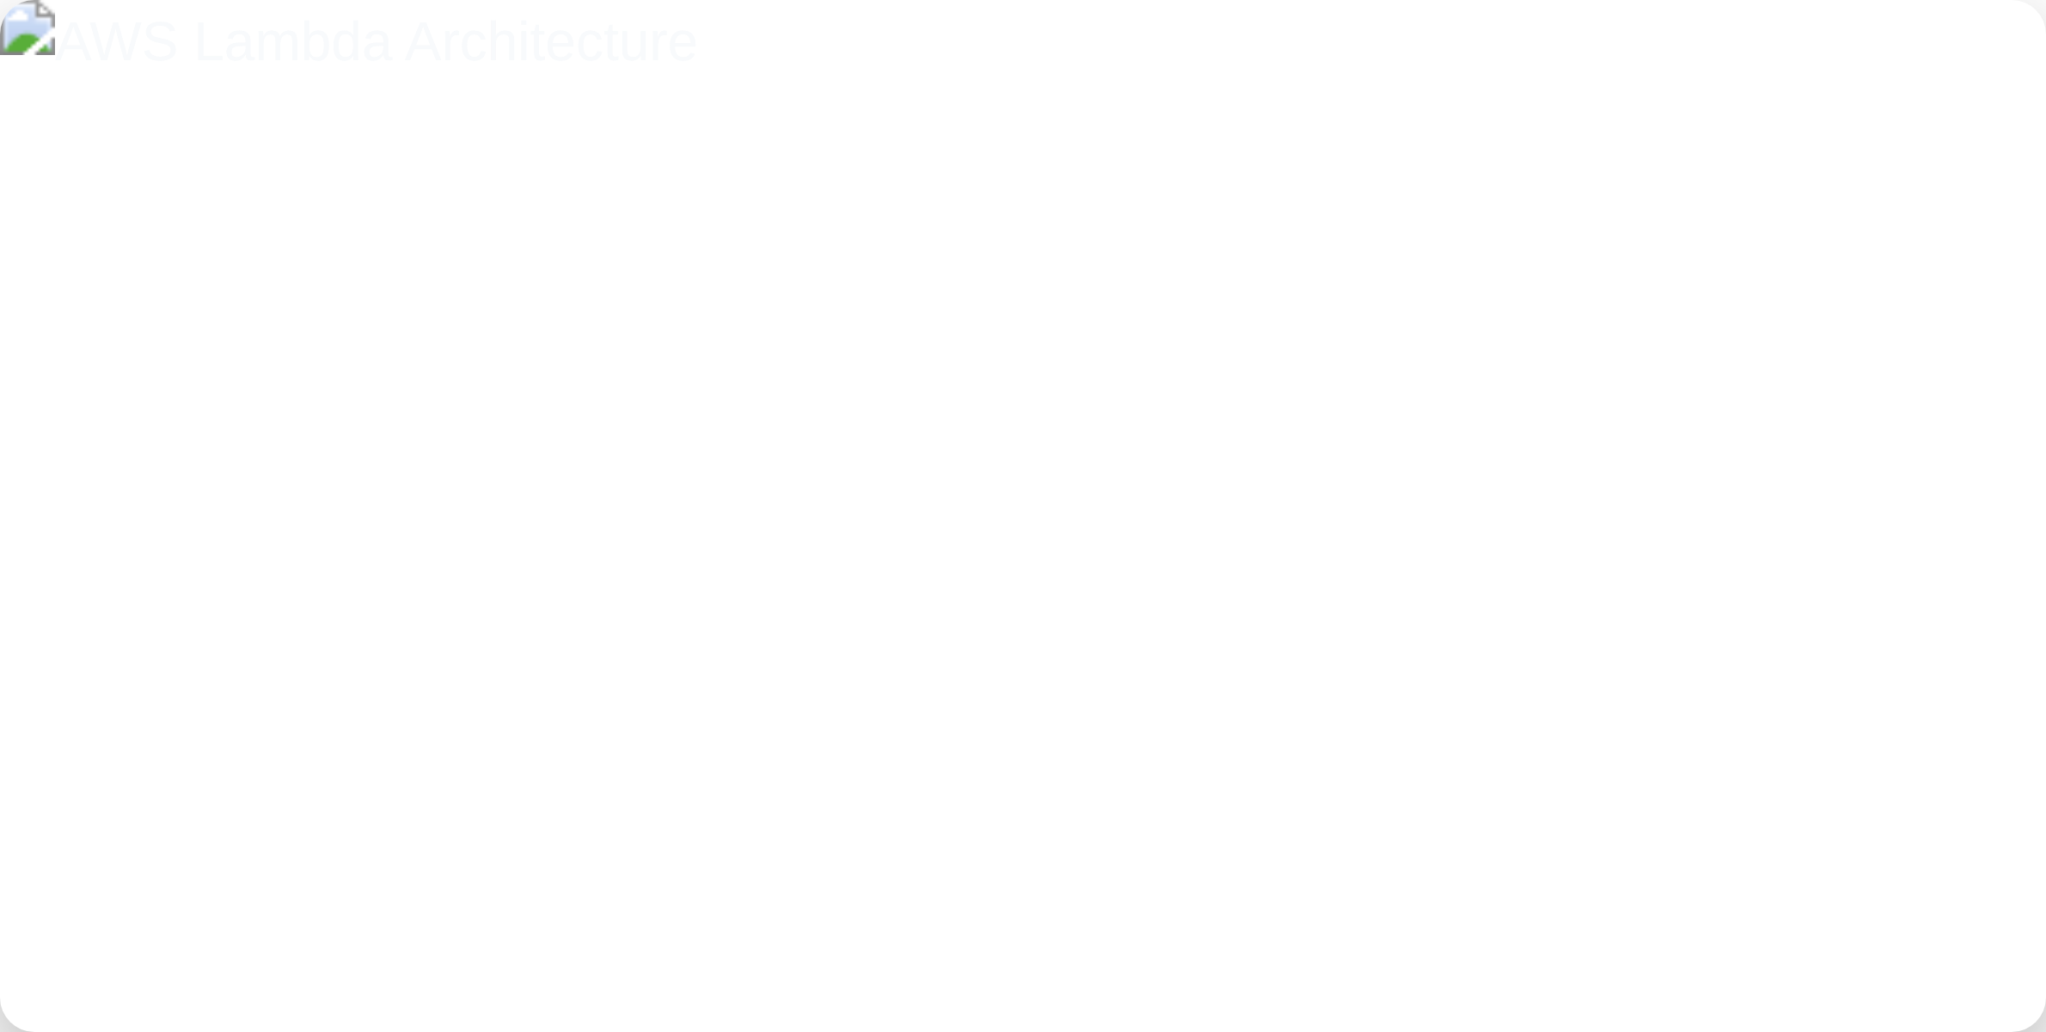

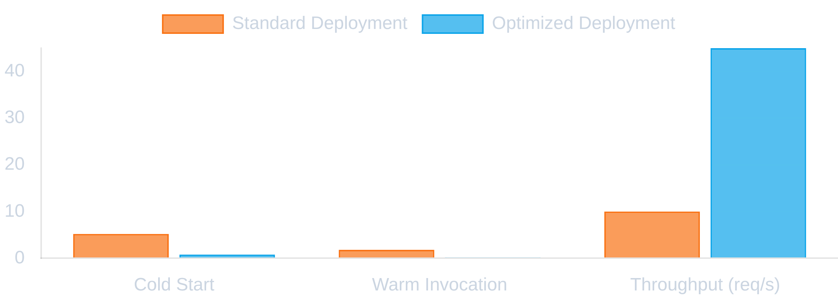
Computer Vision with YOLO: From Basics to Deployment
Deploying YOLO on AWS Lambda
Serverless Computer Vision at Scale
Size Limitations:
Lambda has 250MB package size limit.
Solution:
Use model quantization and container images.
Cold Start Latency:
Initial invocation can be slow.
Solution:
Implement provisioned concurrency and lazy loading.
Memory Constraints:
Limited RAM for large models.
Solution:
Increase allocated memory and optimize inference.
Execution Timeout:
15-minute maximum runtime.
Solution:
Split processing pipeline into multiple functions.
1
Optimize Model
Performance Metrics
Prune and quantize the YOLO model to reduce size and improve inference speed.
2
Package Dependencies
Create deployment package with model weights and required libraries.
3
Configure API Gateway
Set up HTTP endpoints to trigger Lambda function.
4
Implement Monitoring
Add CloudWatch metrics and logs for performance tracking.

Slide 8



Computer Vision with YOLO: From Basics to Deployment
Live Demo & Results
See the Complete System in Action
Flask API Demo
AWS Lambda Demo
Try the real-time object detection API with your own images.
Test the serverless deployment with optimized performance.
Launch Demo
Launch Demo
99.2%
87.5%
45ms
100+
Uptime
mAP@0.5
Avg. Response Time
Requests/Second
Thank you for your attention!

